Slide 1
Lecture 8

Slide 2

Kruskal’s minimum spanning tree
Create a forest of trees from the vertices.
Repeatedly merge trees by adding “safe edges” until
only one tree remains.
A “safe edge” is an edge of minimum weight which
does not create a cycle.

Slide 3
Algorithm: Kruskal’s
Initialization
a) Create a set for each vertex v ∈ V
b) Initialize the set of “safe edges” A comprising the MST to the empty set
c) Sort edges by increasing weight
9
b
a
2
6
F = {a}, {b}, {c}, {d}, {e}
A = ∅
E = {(a,d), (c,d), (d,e), (a,c), (b,e), (c,e), (b,d), (a,b)}
d
4
5
5
4
5
e
c

Slide 4

Algorithm: Kruskal’s
2. For each edge (u,v) ∈ E in increasing order while more than one set remains:
If u and v, belong to different sets U and V
a. add edge (u,v) to the safe edge set
A = A ∪ {(u,v)}
b. merge the sets U and V
F = F - U - V + (U ∪ V)
Return A

Slide 5
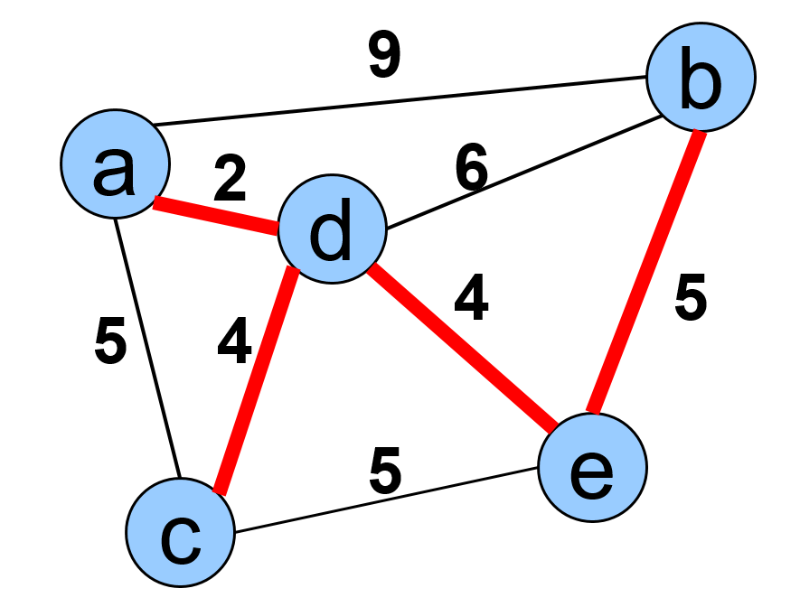
Example 1: Kruskal minimum spanning tree
E = {(a,d), (c,d), (d,e), (a,c), (b,e), (c,e), (b,d), (a,b)}
Forest | A
{a}, {b}, {c}, {d}, {e} | ∅
{a,d}, {b}, {c}, {e} | {(a,d)}
{a,d,c}, {b}, {e} | {(a,d), (c,d)}
{a,d,c,e}, {b} | {(a,d), (c,d), (d,e)}
{a,d,c,e,b} | {(a,d), (c,d), (d,e), (b,e)}

Slide 6
Example 2: Kruskal minimum spanning tree
5
A
B
4
6
2
C
2
D
3
3
1
2
E
F
4

Slide 7
Example 2: Kruskal minimum spanning tree
5
A
B
4
6
2
C
2
D
3
3
1
2
E
F
4

Slide 8
Example 2: Kruskal minimum spanning tree
5
A
B
4
6
2
C
2
D
3
3
1
2
E
F
4

Slide 9
Example 2: Kruskal minimum spanning tree
5
A
B
4
6
2
C
2
D
3
3
1
2
E
F
4

Slide 10
Example 2: Kruskal minimum spanning tree
5
A
B
4
6
2
C
2
D
3
3
1
2
E
F
4

Slide 11
Example 2: Kruskal minimum spanning tree
5
A
B
4
6
2
C
2
D
3
cycle!!
3
1
2
E
F
4

Slide 12
Example 2: Kruskal minimum spanning tree
5
A
B
4
6
2
C
2
D
3
3
1
2
E
F
4

Slide 13
Example 2: Kruskal minimum spanning tree
5
A
B
4
6
2
C
2
D
3
3
1
2
E
F
4

Slide 14
Example 2: Kruskal minimum spanning tree
The minimum- spanning tree
A
B
2
C
2
D
3
1
2
E
F

Slide 15

Complexity analysis: Kruskal’s algorithm
Sorting of edges takes O(E LogE) time.
After sorting, we iterate through all edges and apply find-union algorithm. The find and union operations can take atmost O(LogV) time.
Overall complexity :O(E LogE + E LogV)

Slide 16
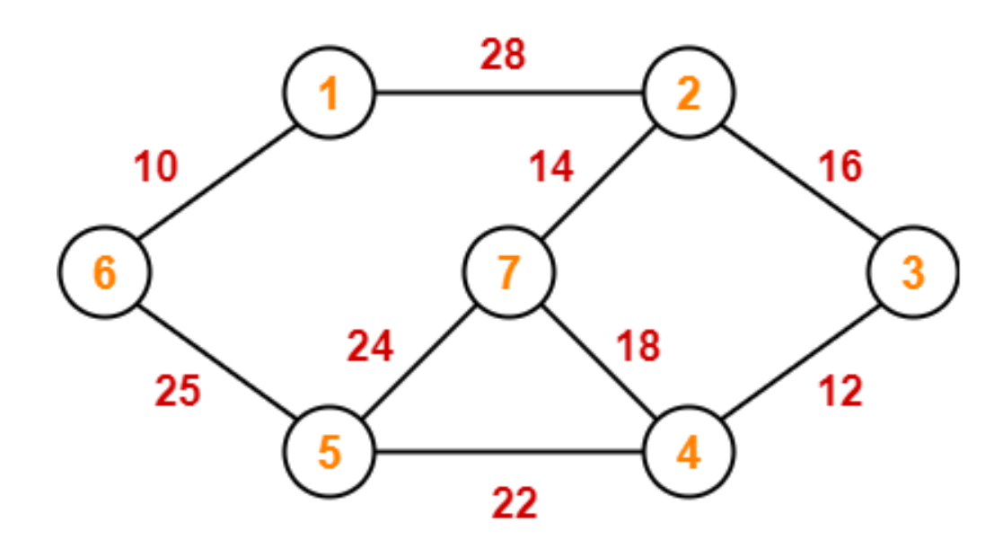
In class Practice
Ques: Construct the minimum spanning tree (MST) for the given graph using Kruskal’s Algorithm

Slide 17
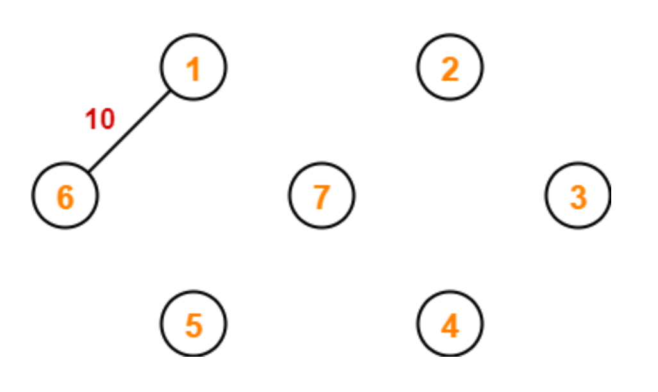
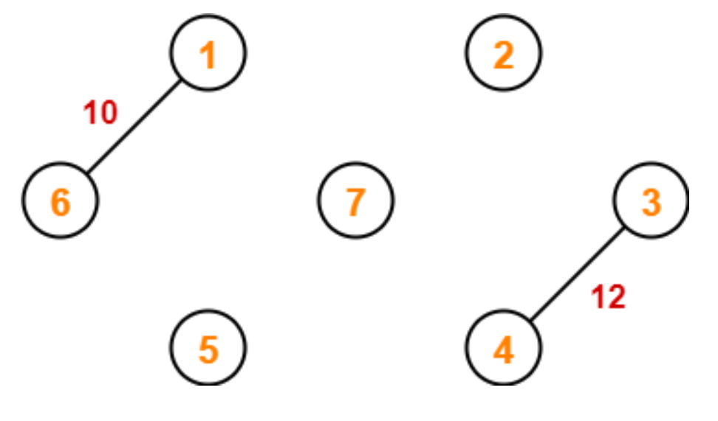
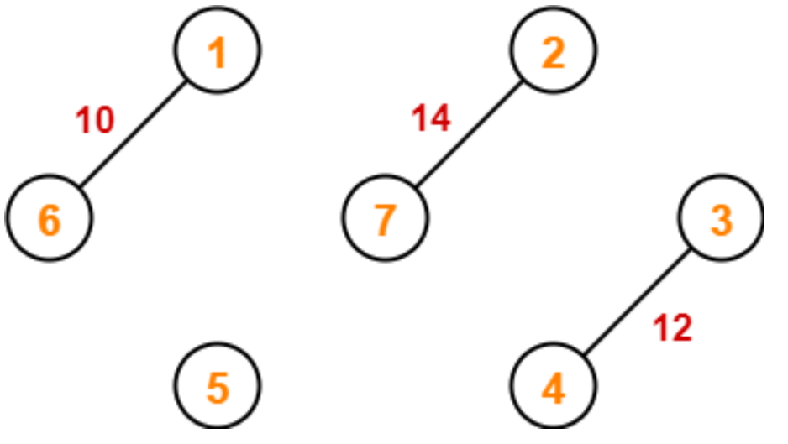
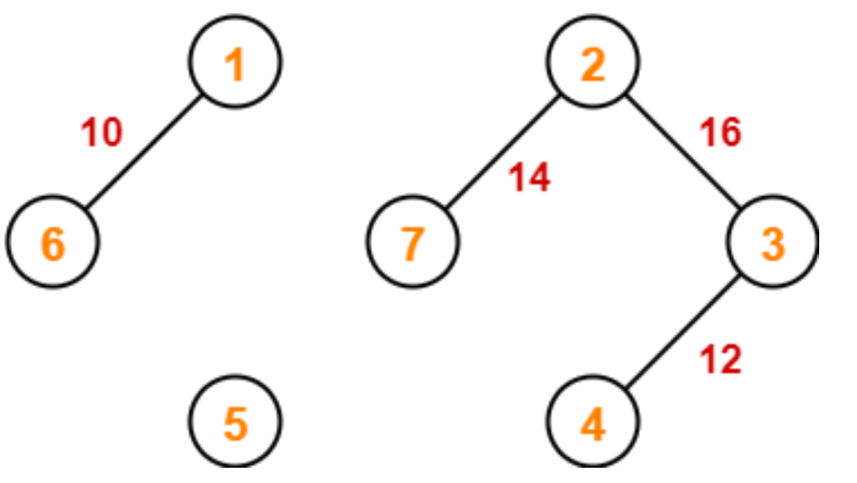
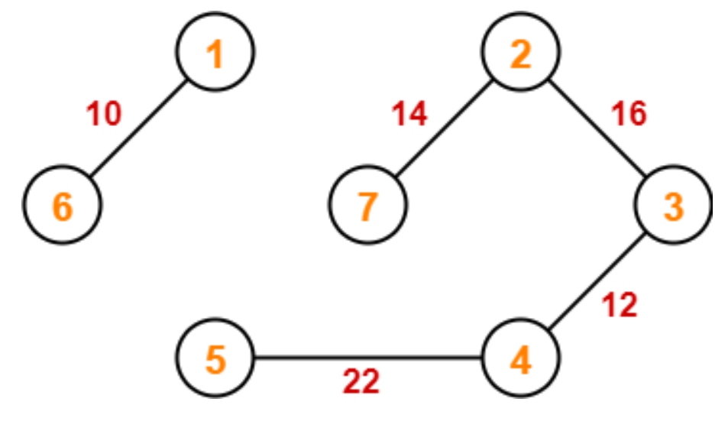
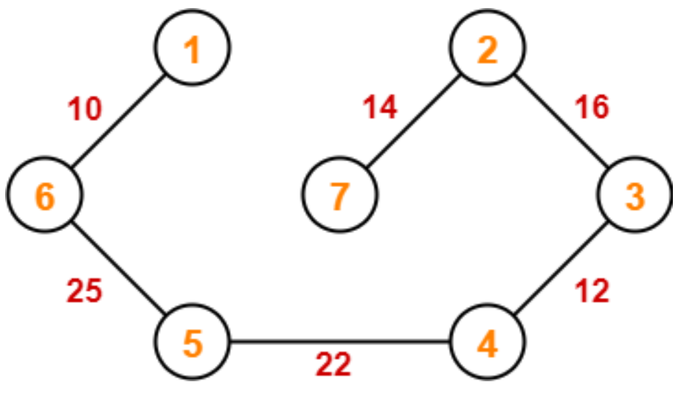
Solution

Slide 18


Slide 19
Shortest Path Problem
Consider Source node 1 and destination node 7.
A direct path between Nodes 1 and 7 will cost 14.
A shorter path will cost only 11

Slide 20
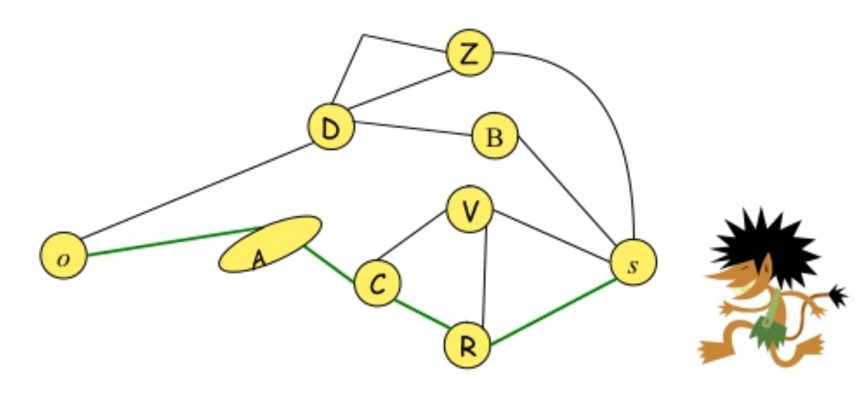
Single source shortest path
Find the shortest path from s to each vertex v_{i}.

Slide 21
Single source shortest path algorithms
Dijkastra’s Algorithm
Bellman Ford algorithm

Slide 22
Dijkastra Algorithm
Dijkstra's algorithm is a solution to the single-source shortest path problem in graph theory.
Works on both directed and undirected graphs.
All edges must have nonnegative weights.
Input: Weighted graph G={E,V} and source vertex v∈V
Output: Lengths of shortest paths (or the shortest paths themselves) from a given source vertex v∈V to all other vertices

Slide 23
Algorithm: Dijakastra
dist[s] ←0 // distance to source vertex is zero for all v ∈ V–{s} do dist[v] ←∞ // set all other distances to infinity S←∅ // S, the set of visited vertices is initially empty Q←V // Q, the queue initially contains all vertices while Q ≠∅ // while the queue is not empty do u ← mindistance(Q,dist) // select the element of Q with the min. distance S←S∪{u} // add u to list of visited vertices for all v ∈ neighbors[u] do if dist[v] > dist[u] + w(u, v) // if new shortest path found then d[v] ←d[u] + w(u, v) // set new value of shortest path
return dist

Slide 24
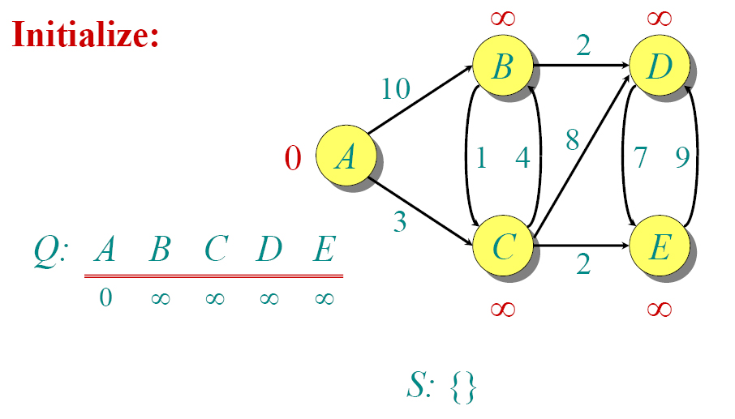
Example: Dijkastra

Slide 25
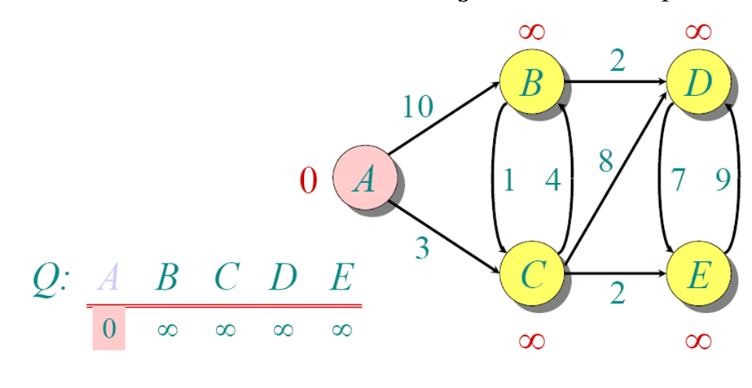
Example: Dijkastra

Slide 26
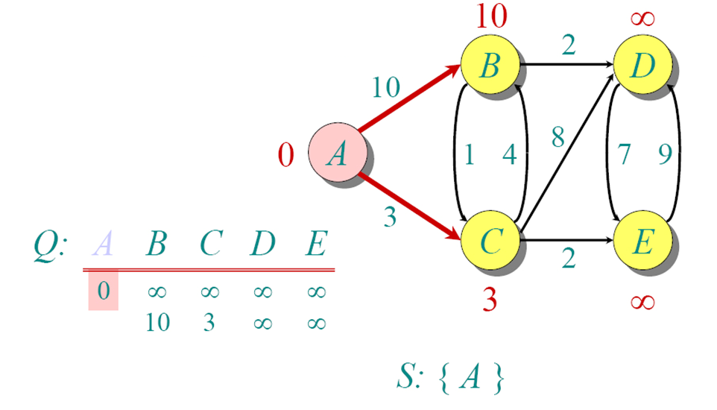
Example: Dijkastra

Slide 27
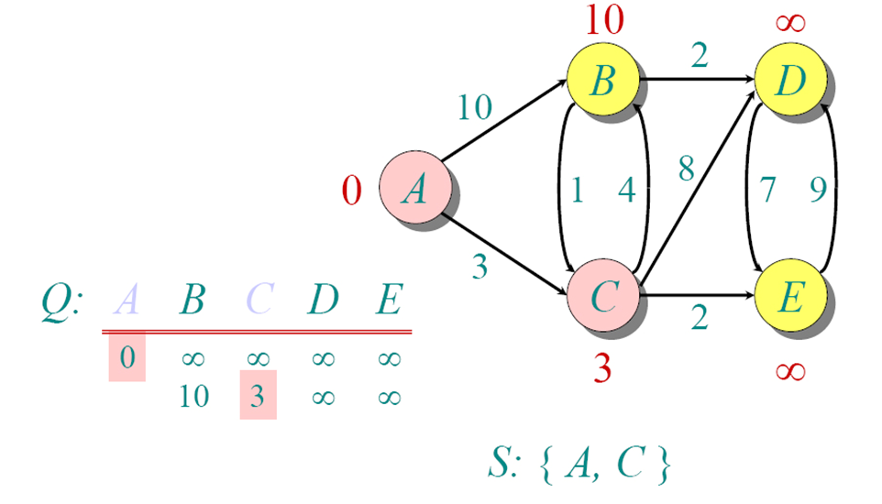
Example: Dijkastra

Slide 28
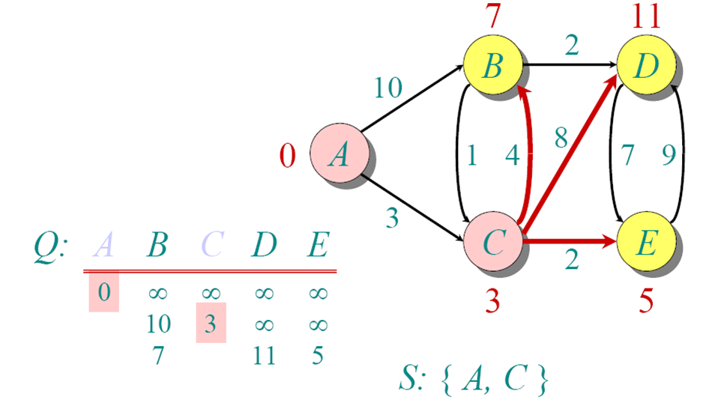
Example: Dijkastra

Slide 29
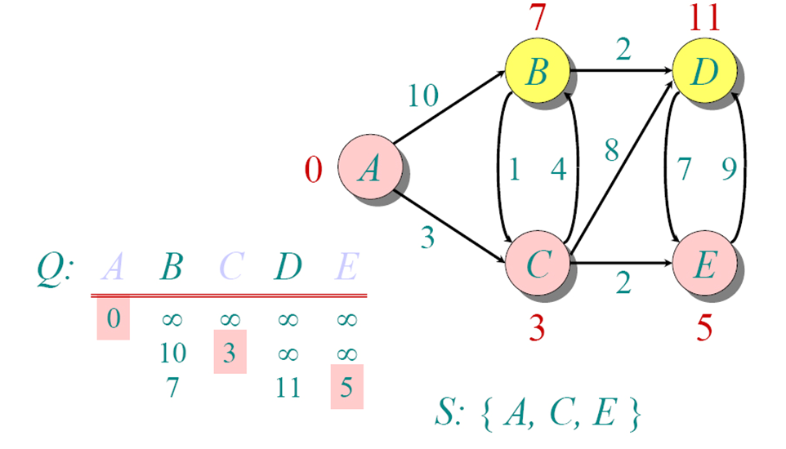
Example: Dijkastra

Slide 30
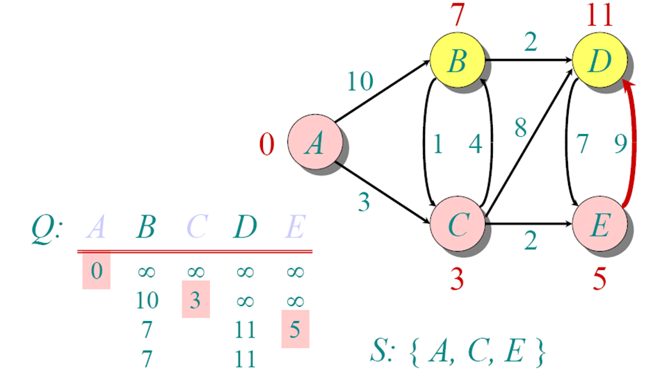
Example: Dijkastra

Slide 31
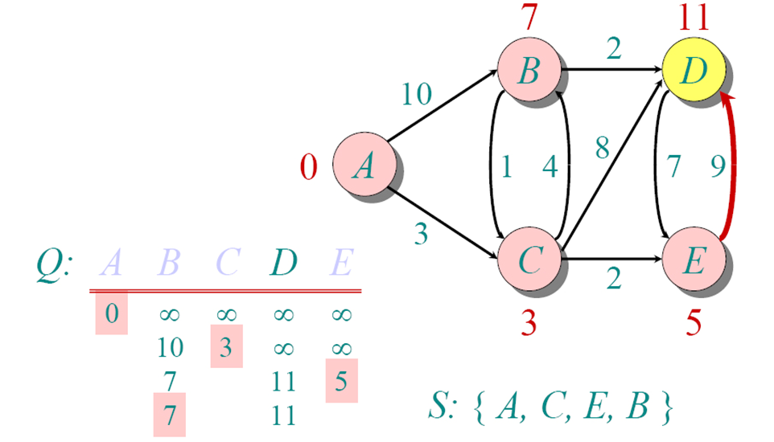
Example: Dijkastra

Slide 32
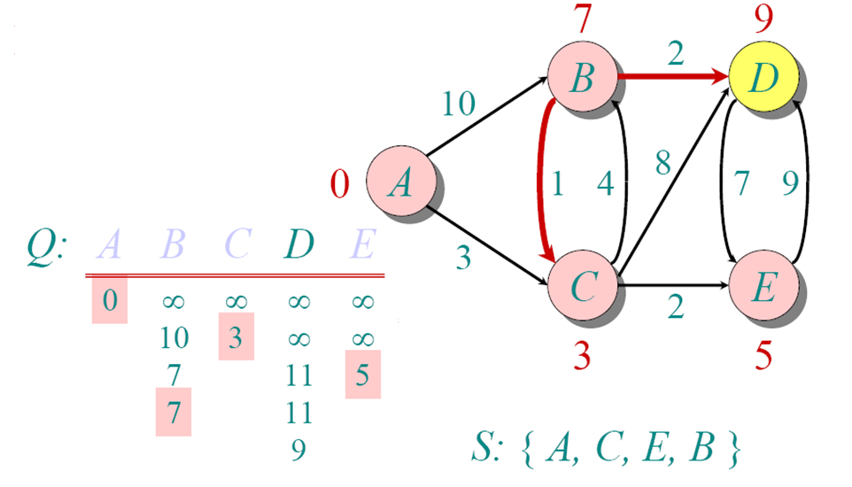
Example: Dijkastra

Slide 33
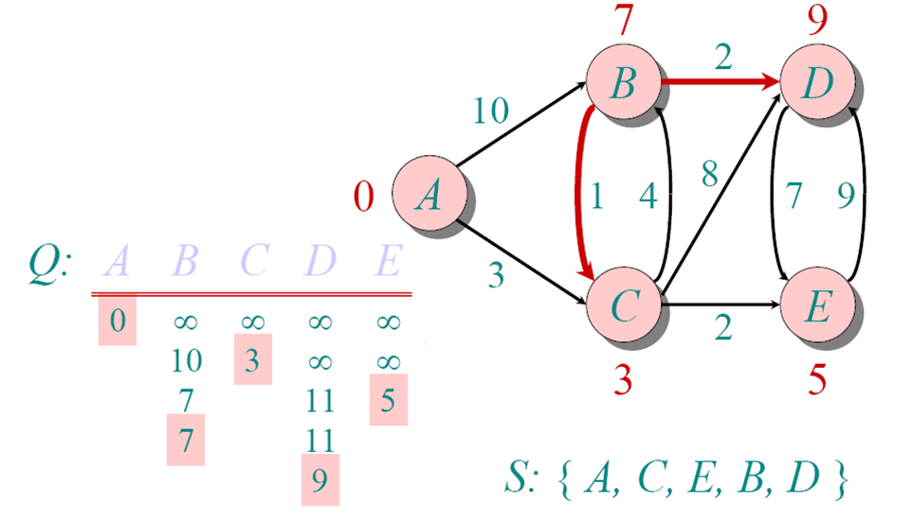
Example: Dijkastra

Slide 34
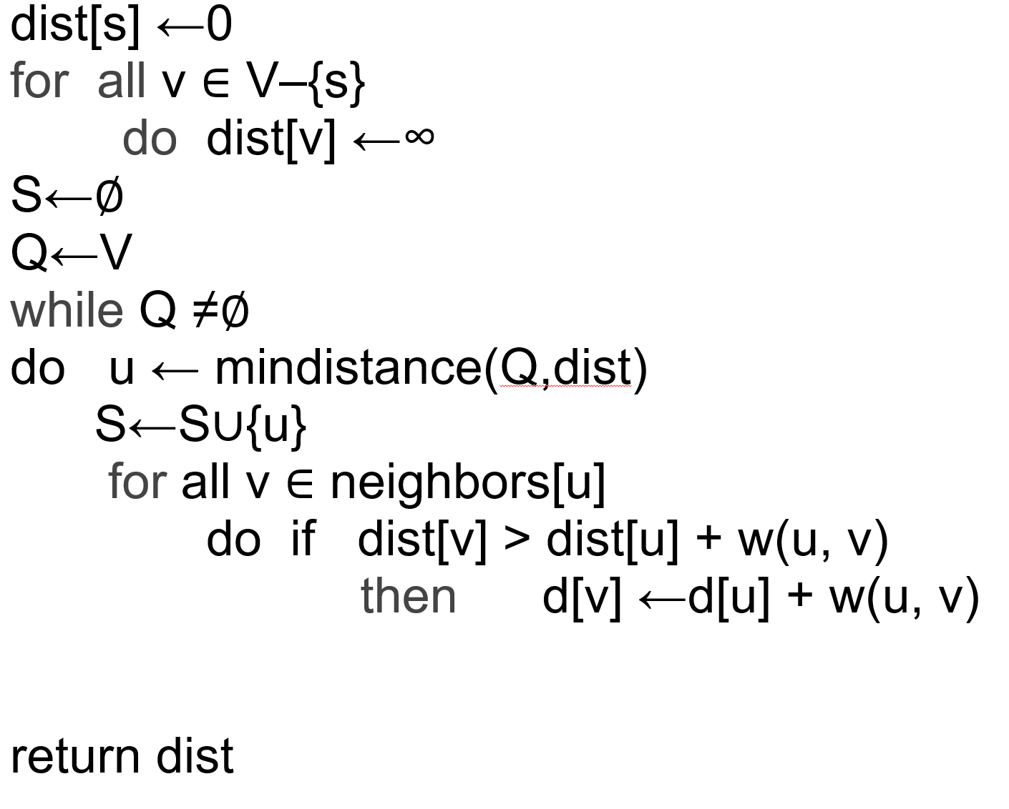
Complexity analysis: Dijkastra
O(V)O(V) time
O(V)
O(V)
O(V log (V))
O(log V)
O(E log V)
O((V+E) log V)

Slide 35
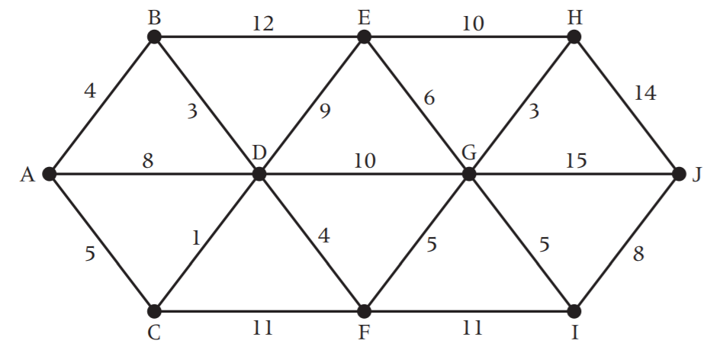
In class Practice
Ques: Find the shortest distance from A to J on the network below using Dijkasta’s algorithm.

Slide 36
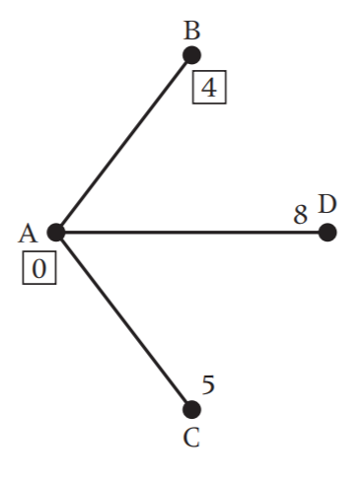
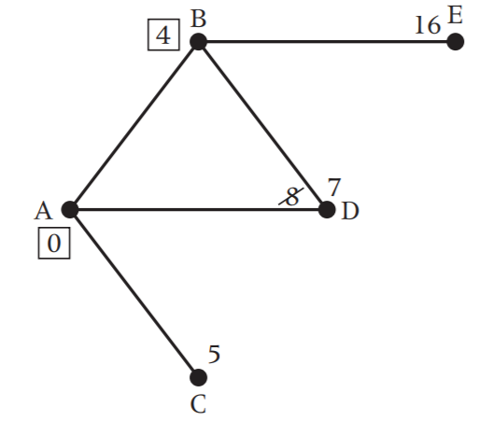
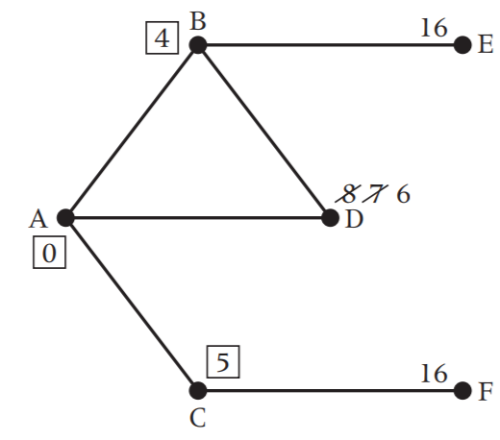
Solution

Slide 37
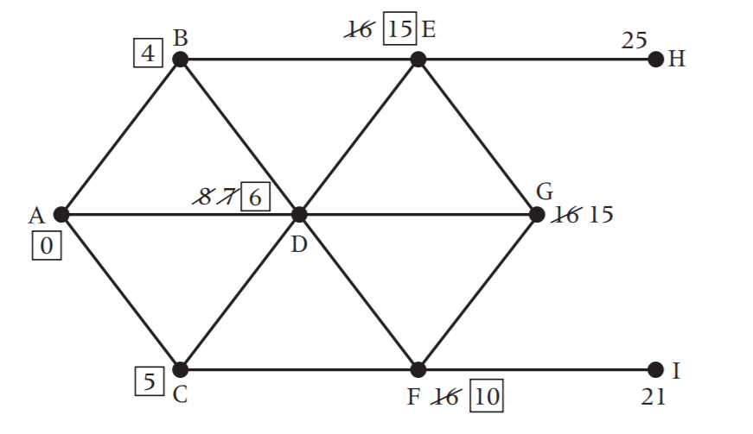
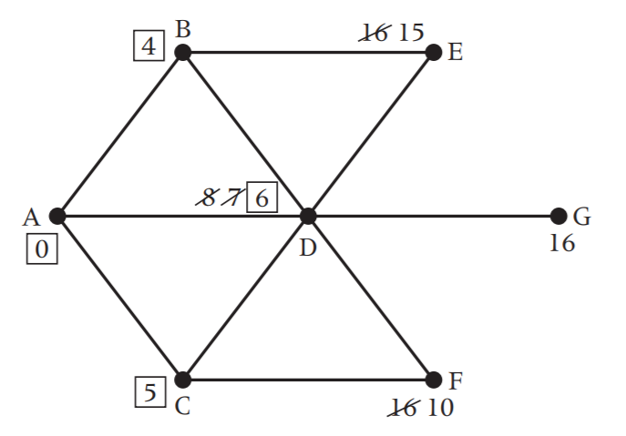
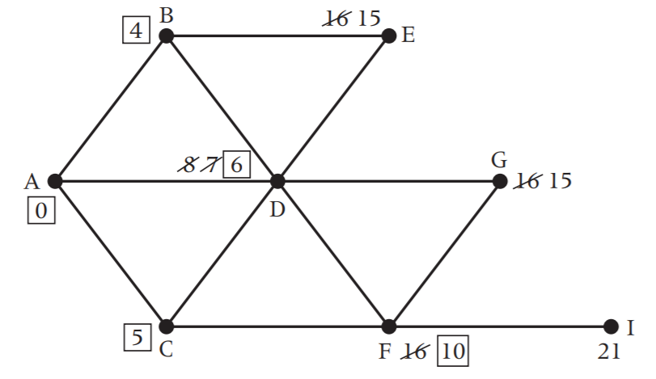
Solution

Slide 38
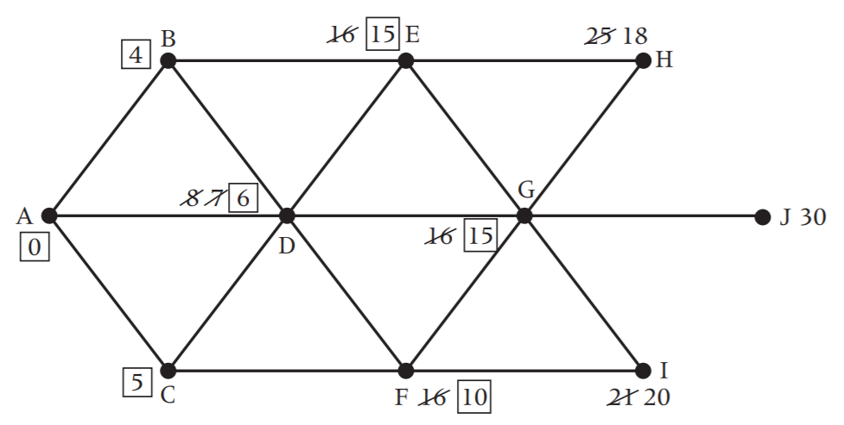
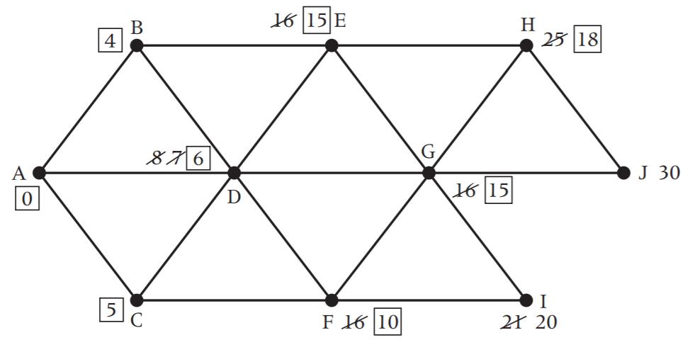

Slide 39
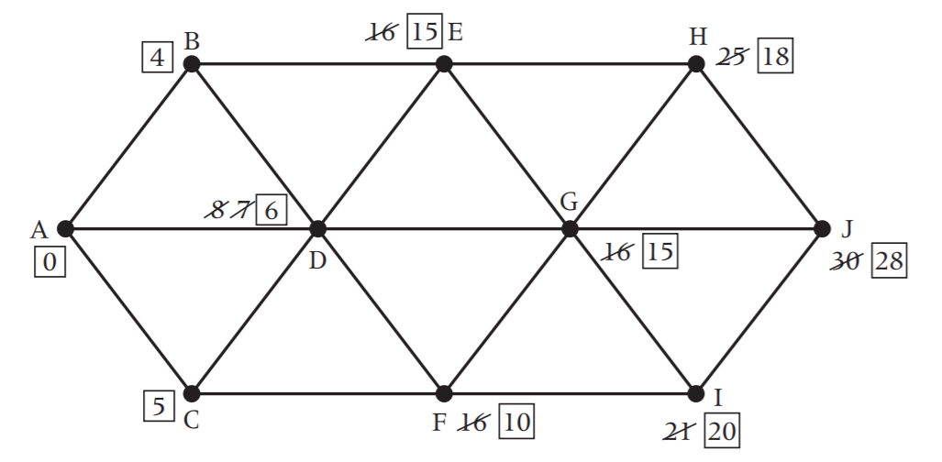
Solution
Final solution:

